Slide 1
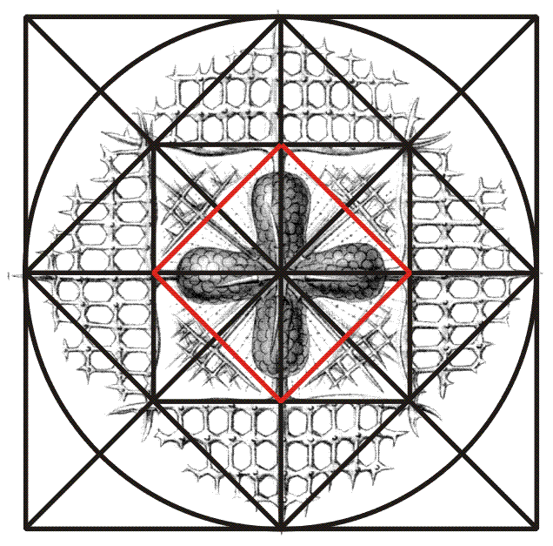
Ad Quadratum Symmetry
Squares
Page 39
Michael S. Schneider
www.constructingtheuniverse.com

Slide 2
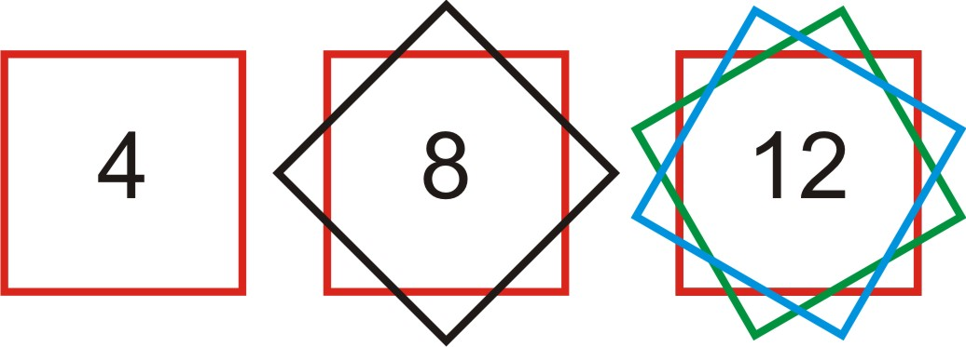
To understand all the shapes in the universe, you only have to know about the numbers
1 2 3 4 5 6 7 8 9 10 11 12
The numbers 1-12
naturally form four groups
First Principles: 1, 2
Numbers of Structure: 3, 4, 6, 8, 12
Numbers of Life: 5, 10
Numbers of Mystery: 7, 9, 11
points

Slide 3
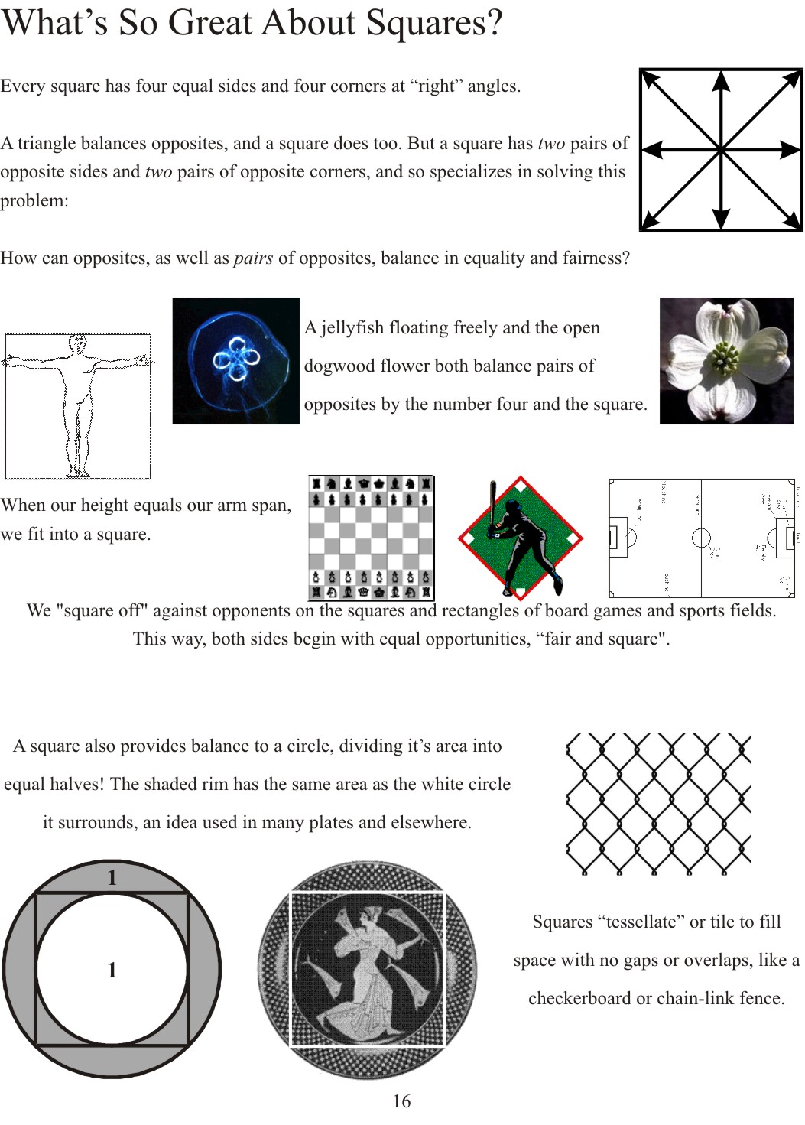
Page 40

Slide 4
1 2 3 4 5 6 7 8 9 10 11 12
A number of Structure
Shape: Square, Cube & Tetrahedron
Number and Shape of
Structure, Matter,
Orderliness
&
Fairness

Slide 5
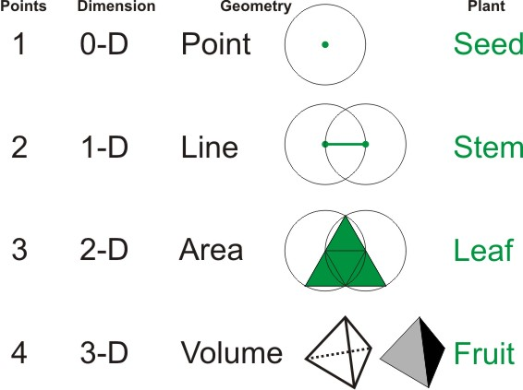
4 Points are the minimum required
to enclose 3-dimensional space
Symbolism of 4: Solid, Structure,
to Manifest in 3 dimensions

Slide 6
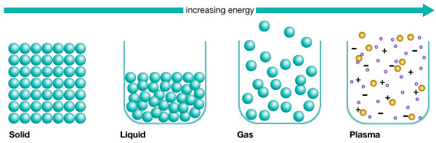
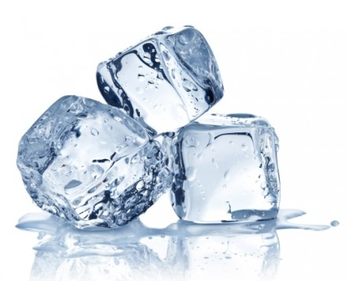


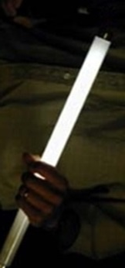
The universe is made of
4 States of Matter
Ancient Modern
“Elements” = “States of Matter”
Fire Plasma
Air Gas
Water Liquid
Earth Solid
Ice
Water
Steam
Fluorescent Light
Nature’s symbolism of 4: to clothe with matter or to Materialize

Slide 7
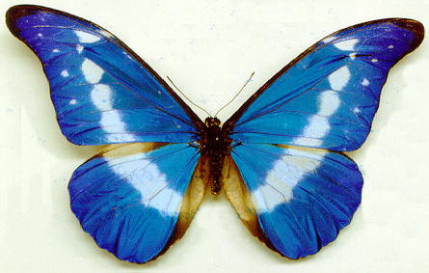
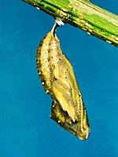
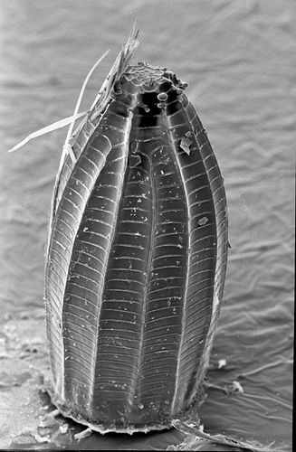

4 stages in the life of a Butterfly
(a “Flutter By”)
Called
“complete metamorphosis”
Adult
Cocoon
or Pupa
Caterpillar
Egg

Slide 8
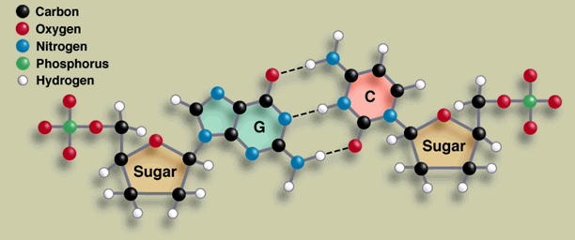
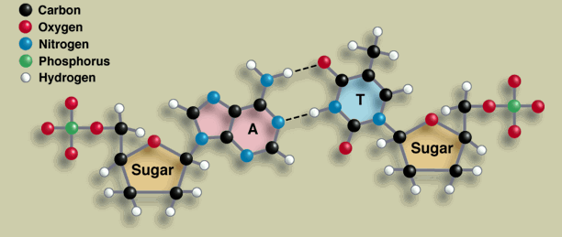
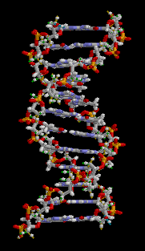
Four DNA genomes (A, G, T, C)

Slide 9
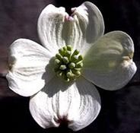
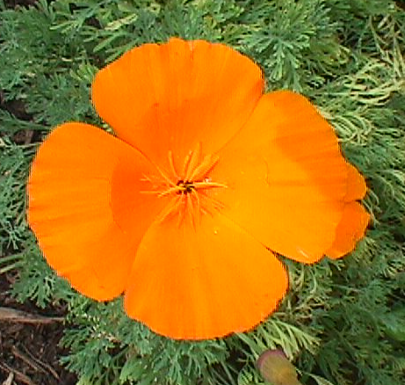

Dogwood
California
Poppy
4-Leaf
Clover

Slide 10
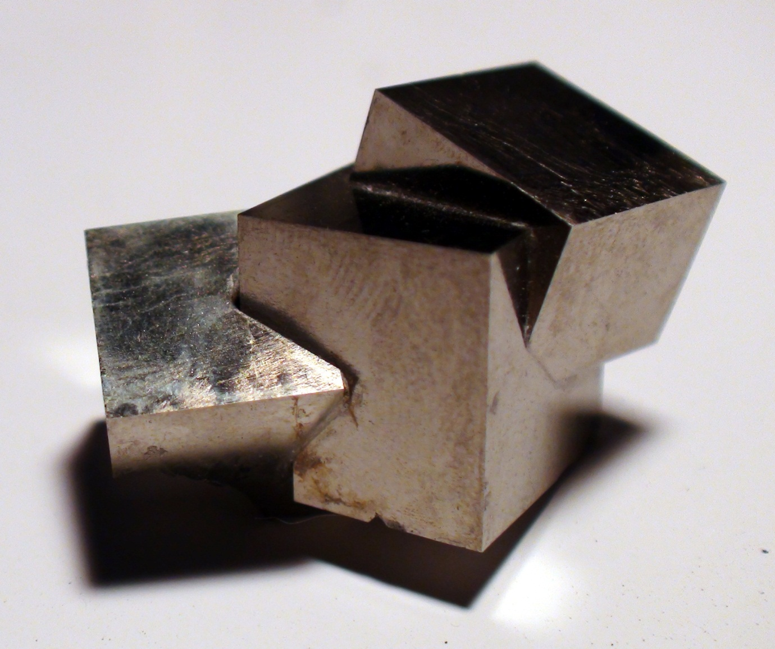
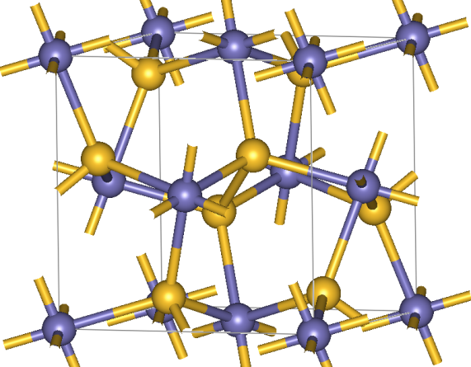
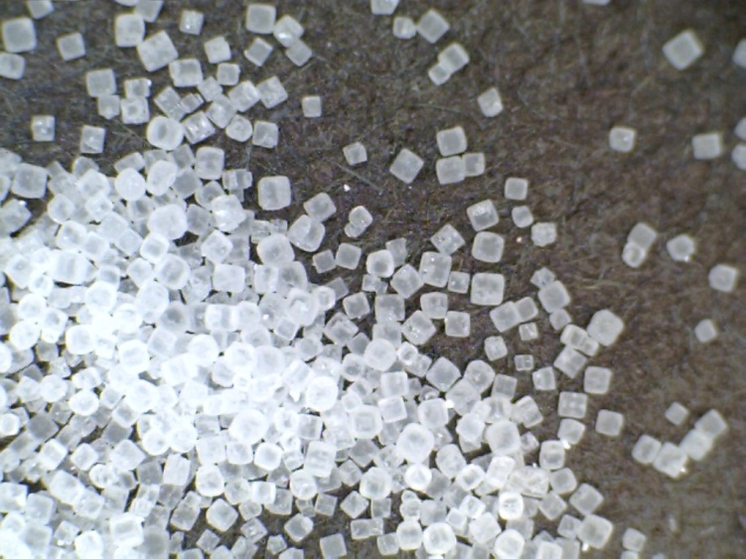
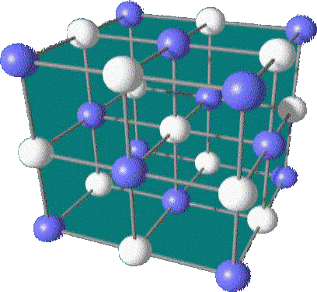
Crystals of
Iron Pyrite
(“Fool’s Gold”)
Salt
NaCl

Slide 11
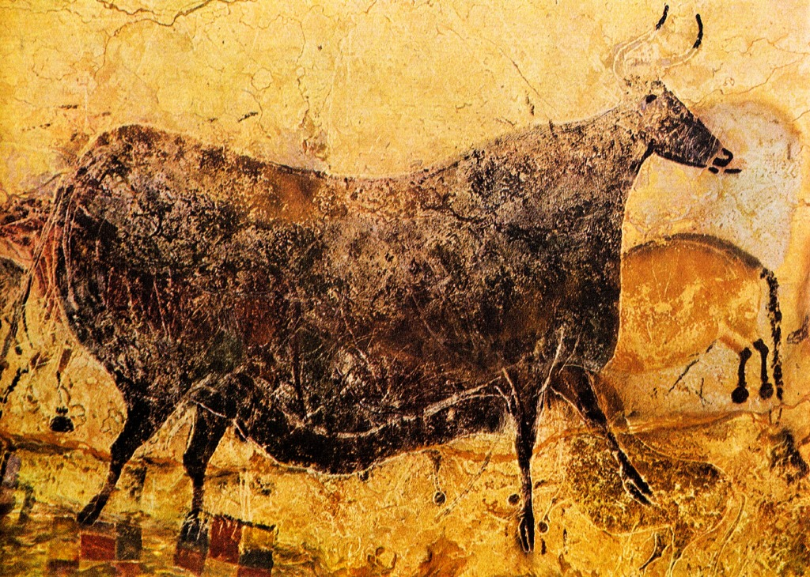
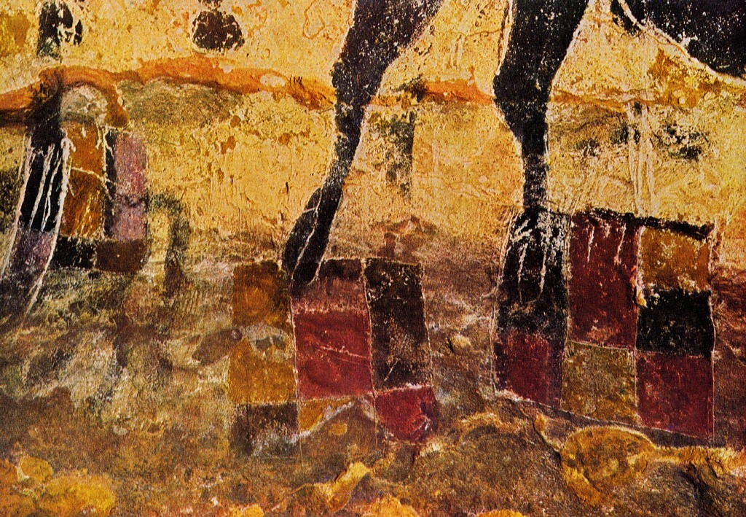

Slide 12
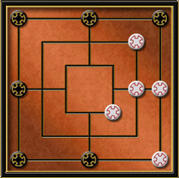
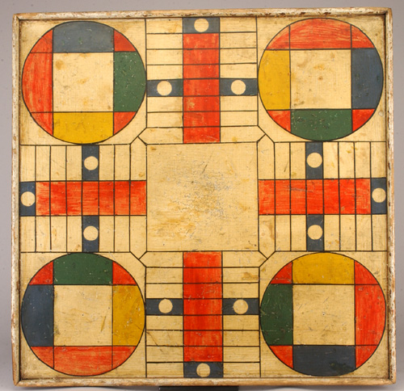
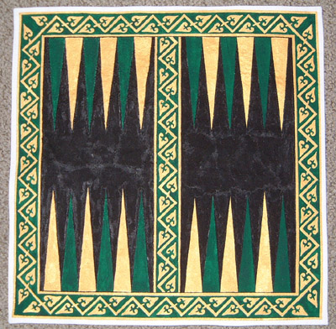

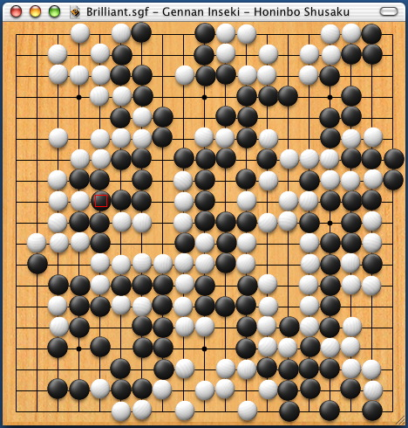
Board Games
The simplest shape
having opposite sides
Fair and Square!

Slide 13

People like to build with squares, rectangles and cubes

Slide 14
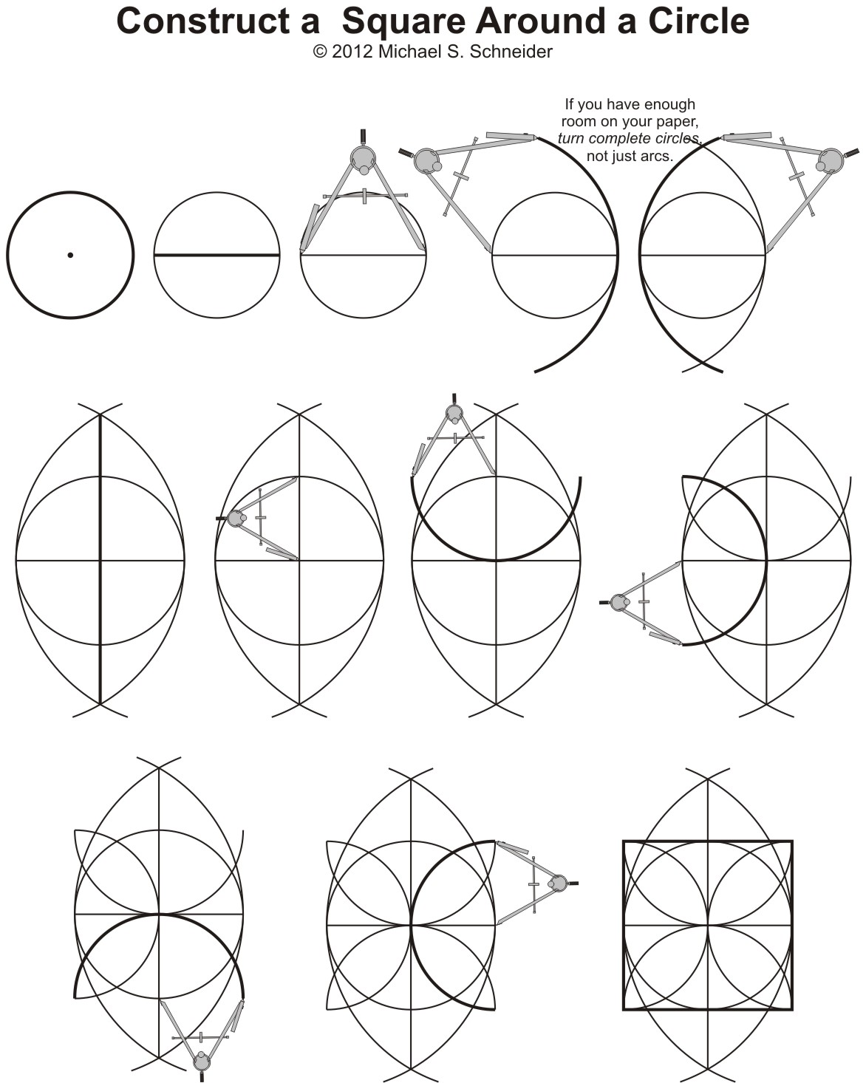
Page 41

Slide 15
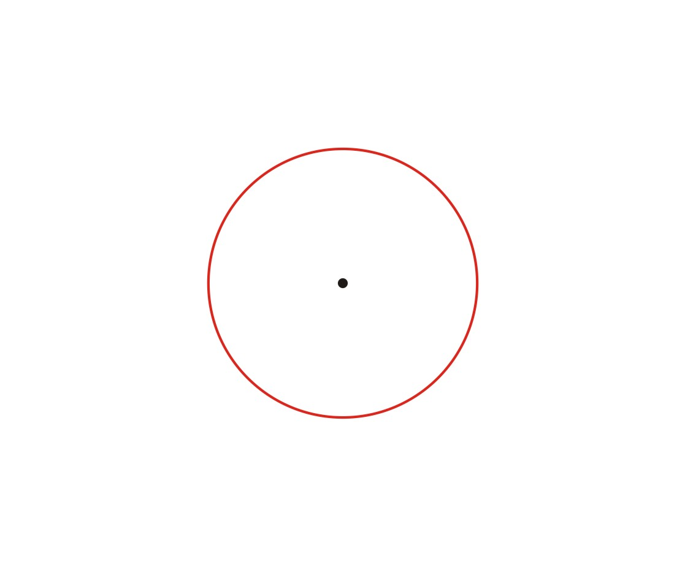

Slide 16
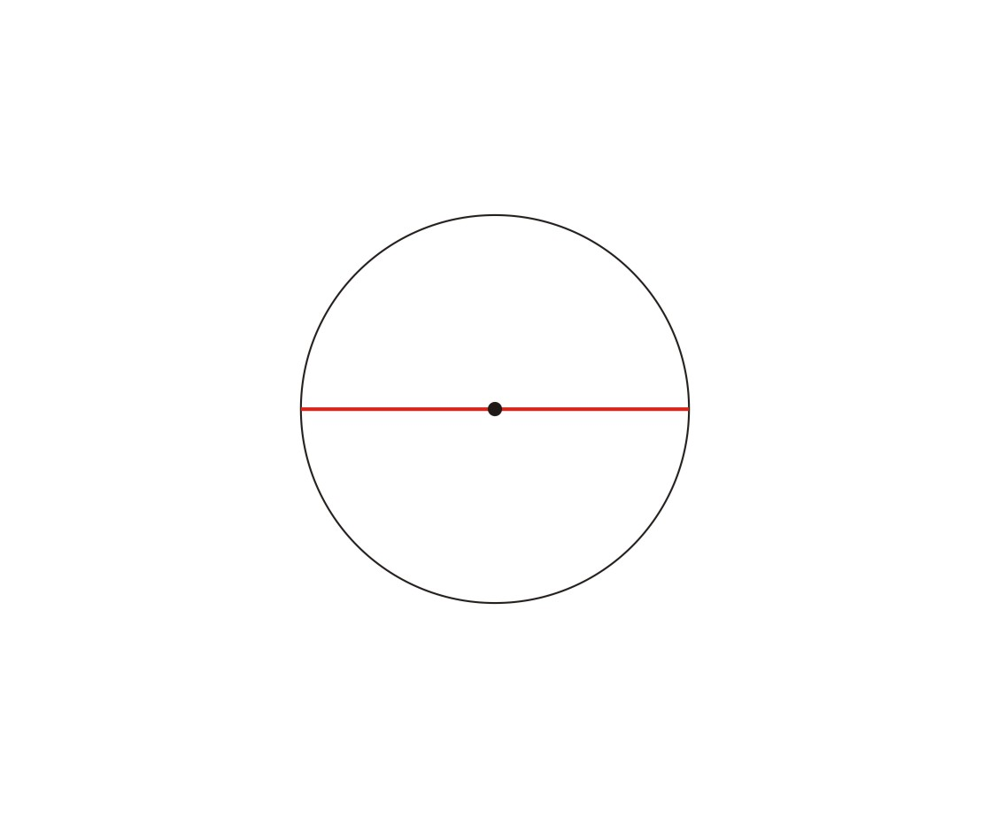

Slide 17
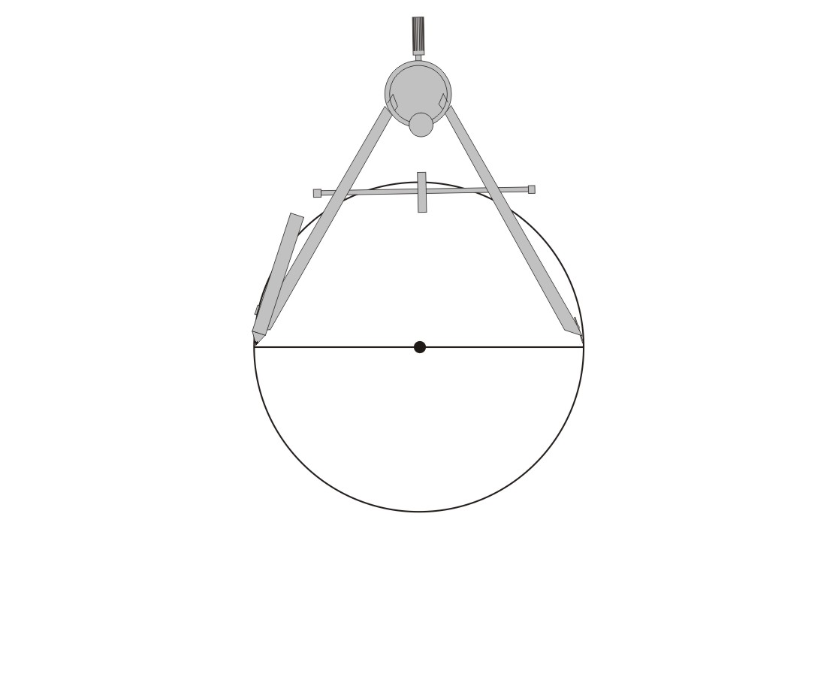

Slide 18
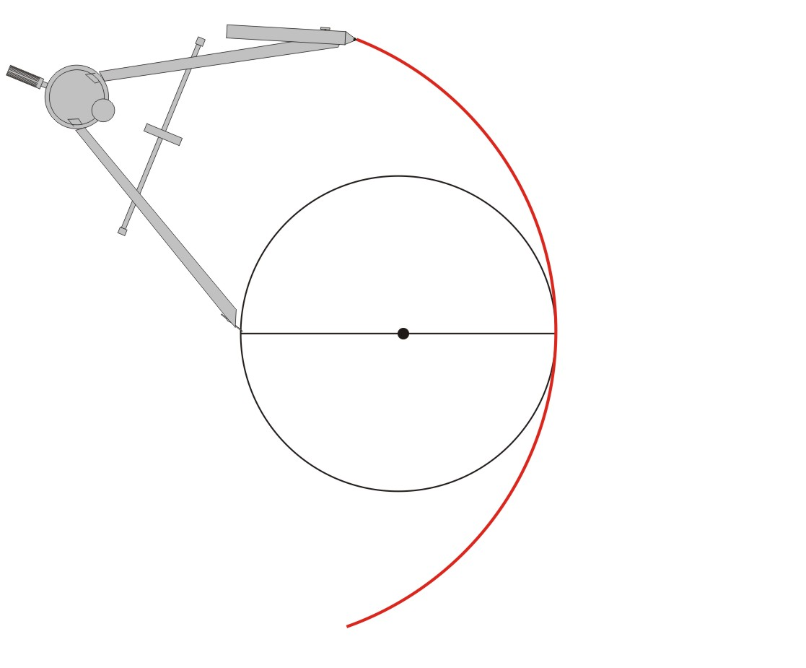

Slide 19
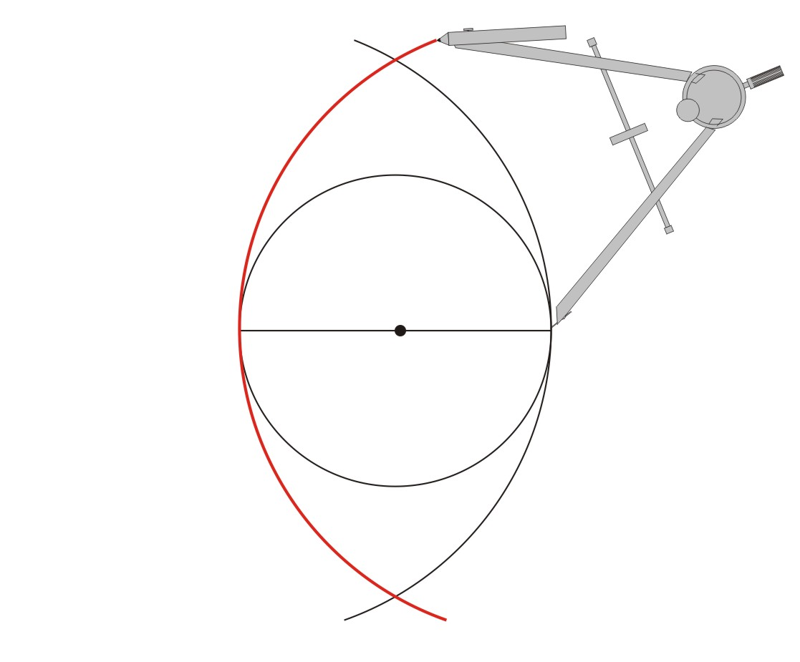
Italian & Sanskrit (India):
Mandorla
Almond
(husk, shell, nut)
Latin: Vesica Piscis
(“bladder of the fish”)

Slide 20
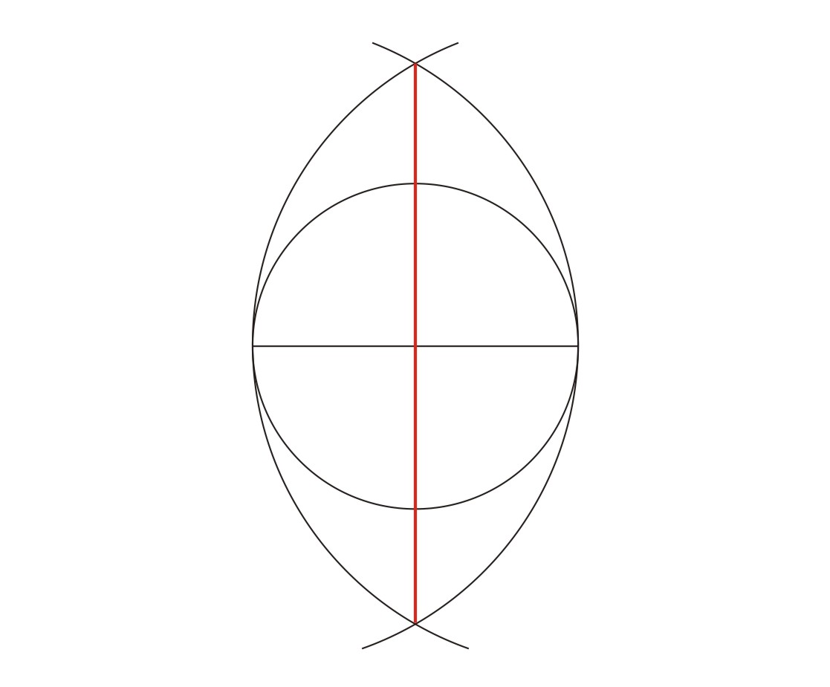

Slide 21
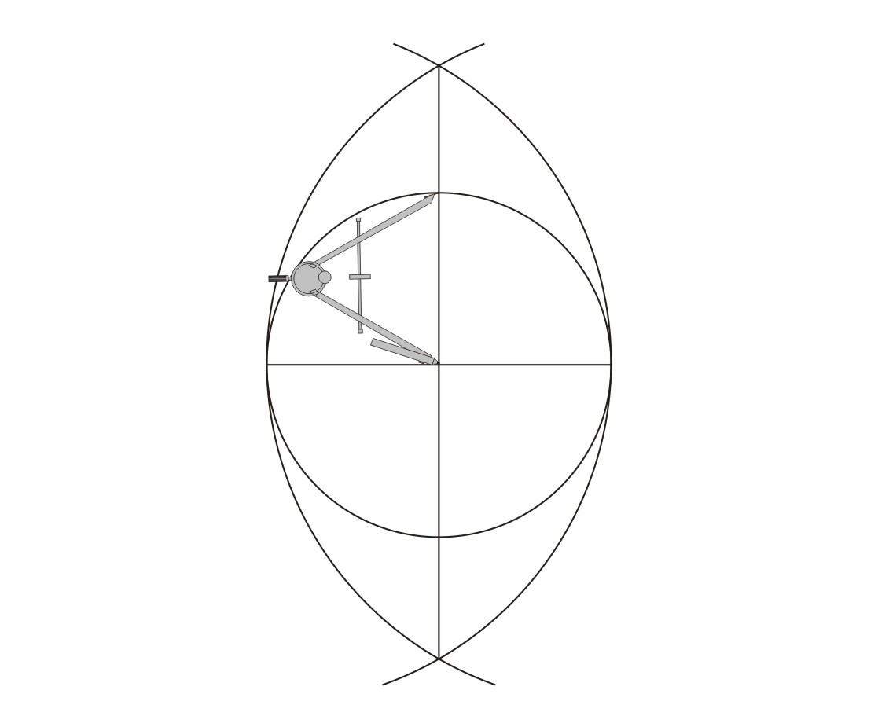

Slide 22
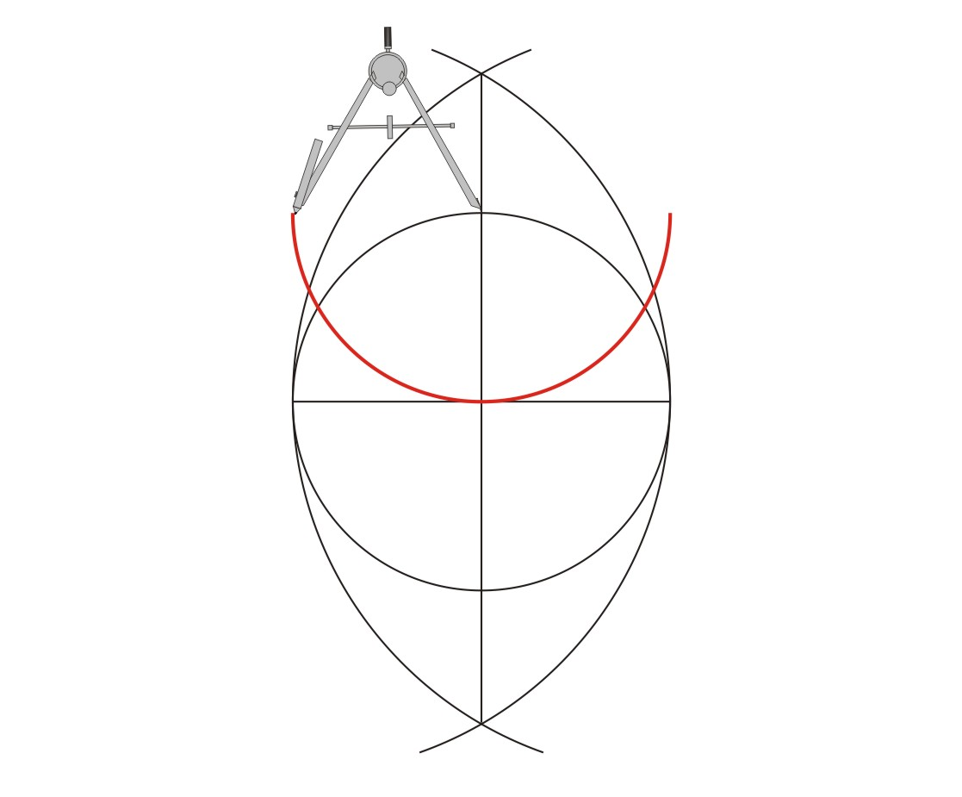

Slide 23
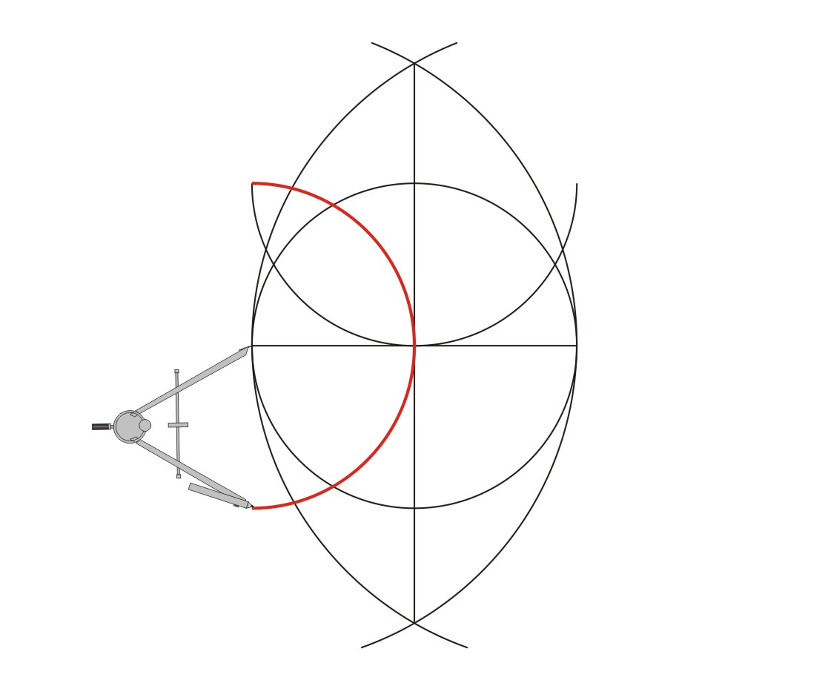

Slide 24
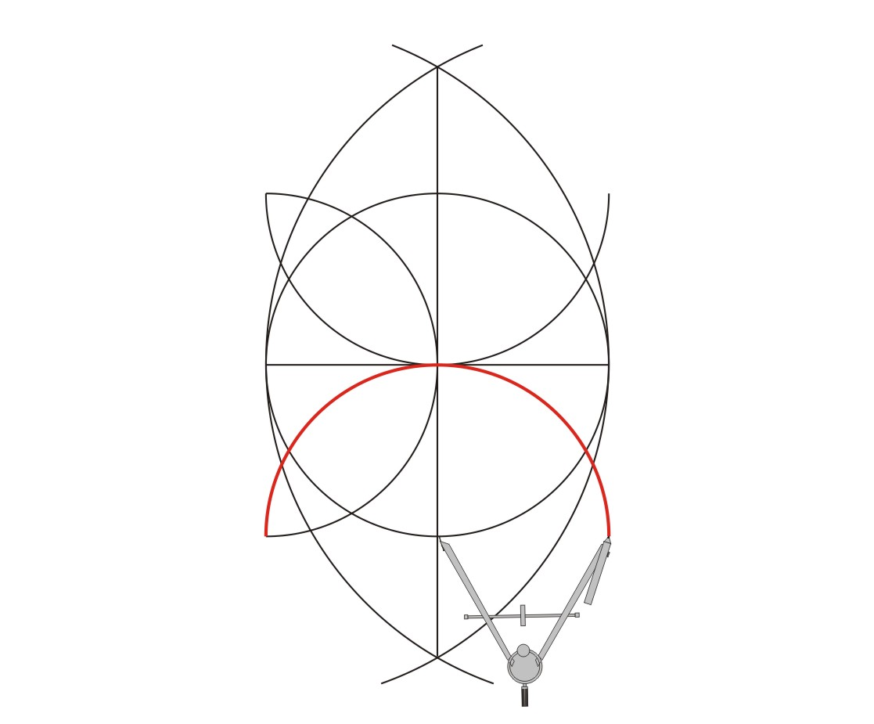

Slide 25
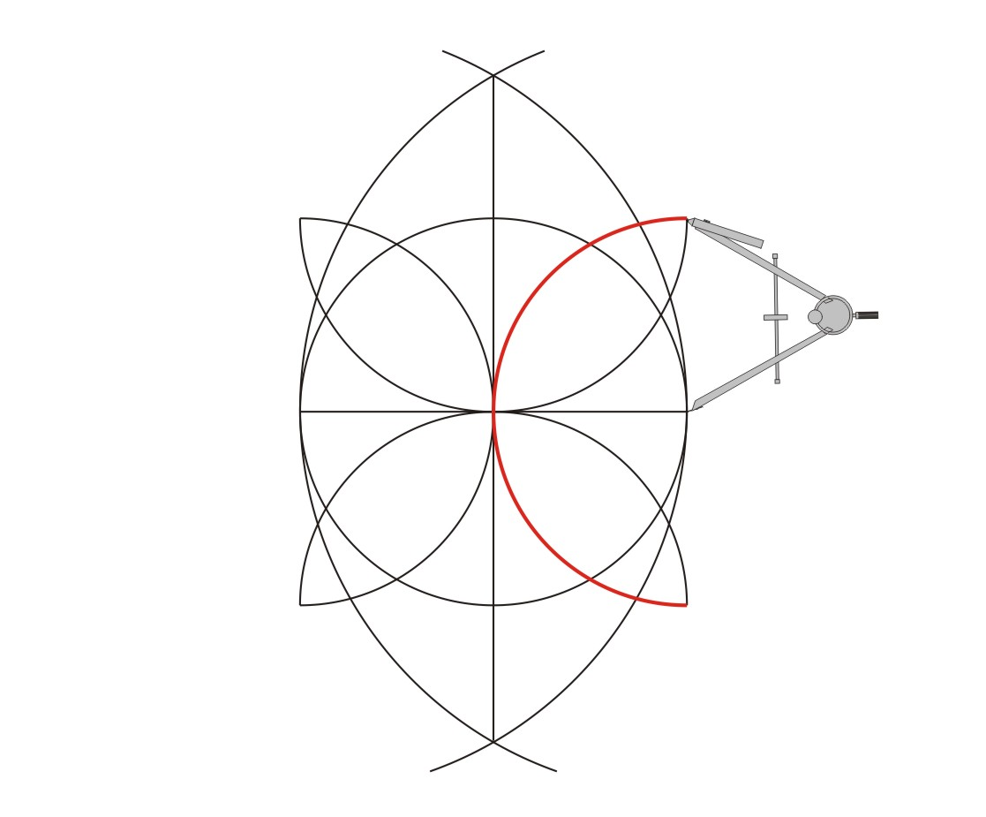

Slide 26
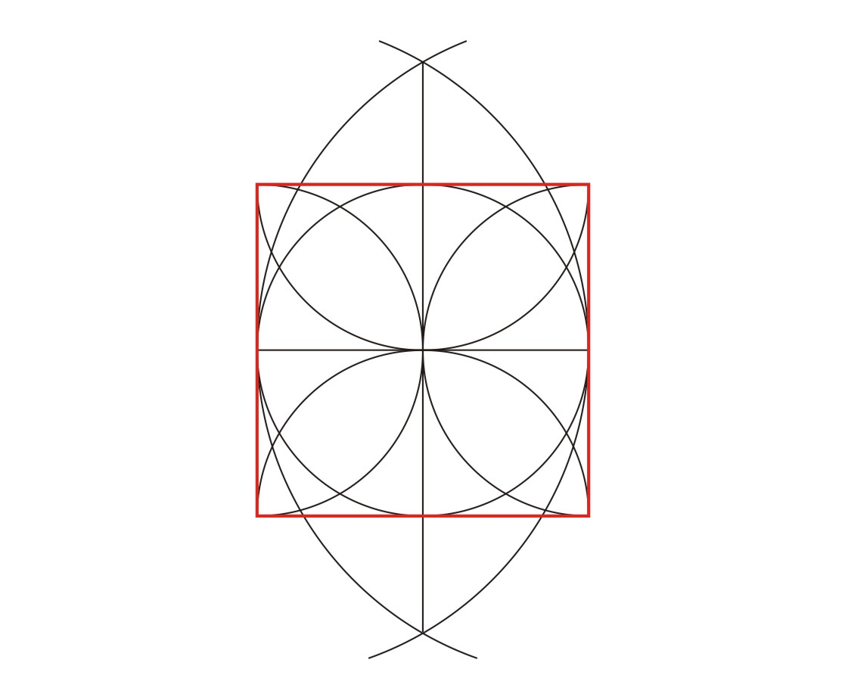

Slide 27
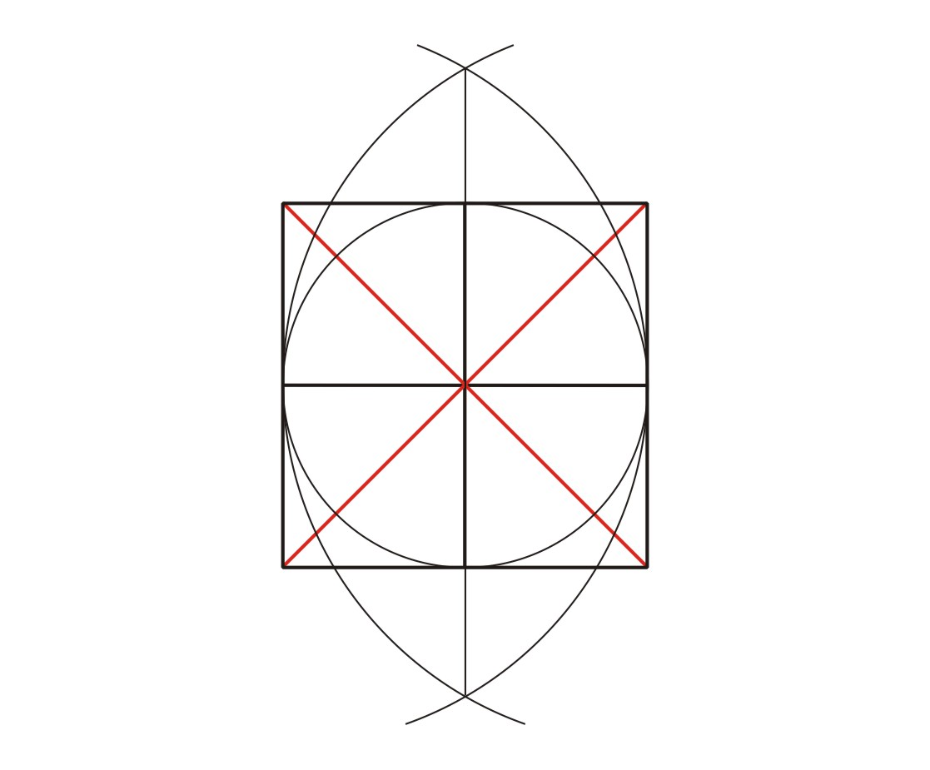
Page 42
To Subdivide A Square
draw its cross and diagonals

Slide 28
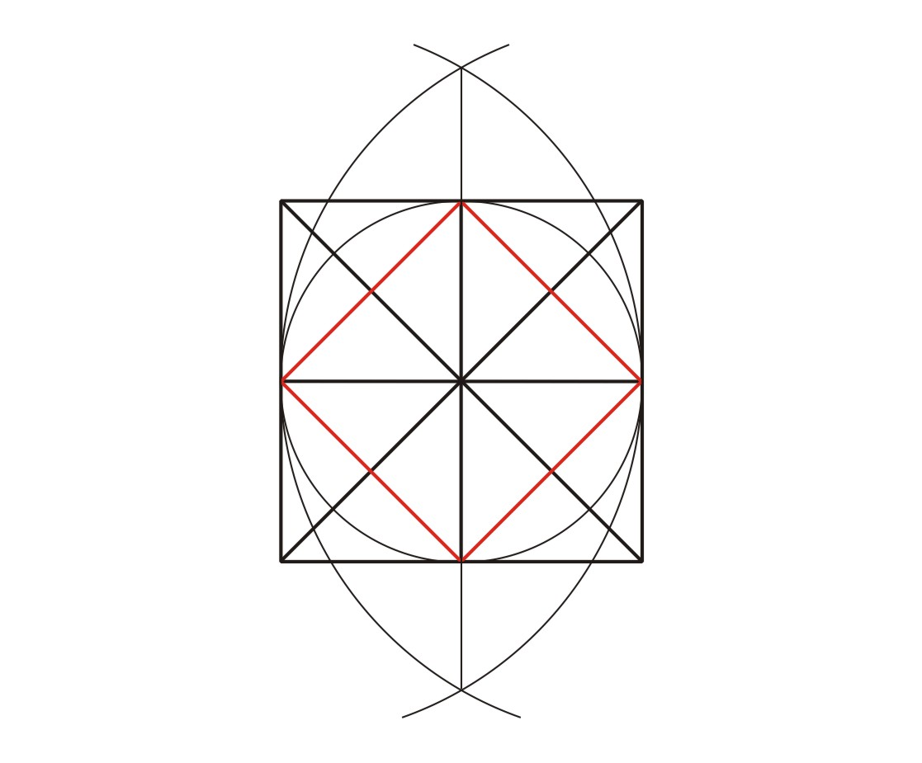

Slide 29
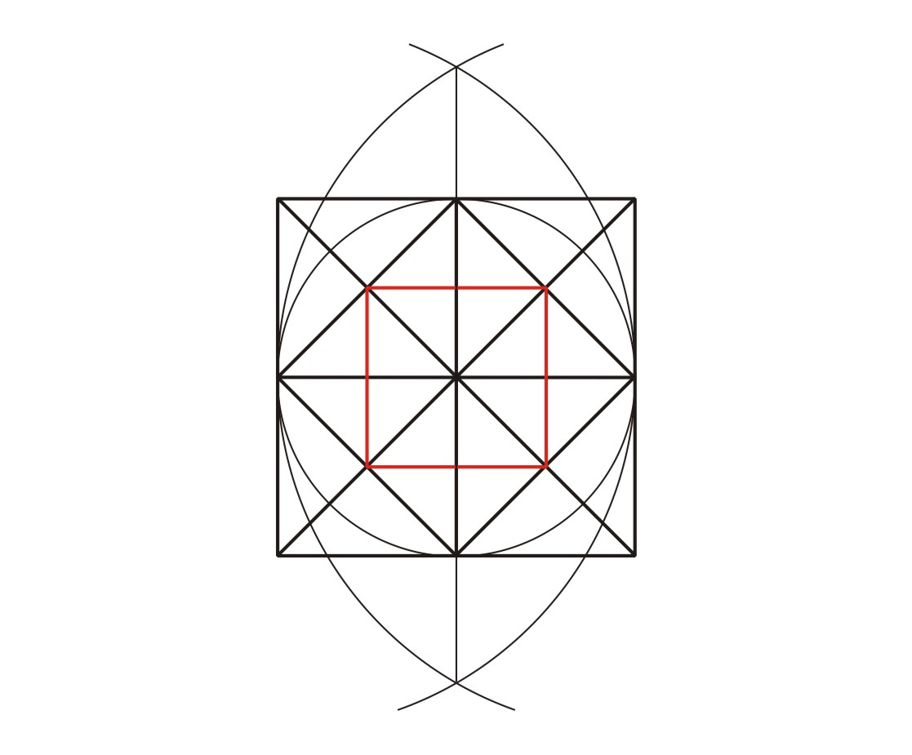

Slide 30
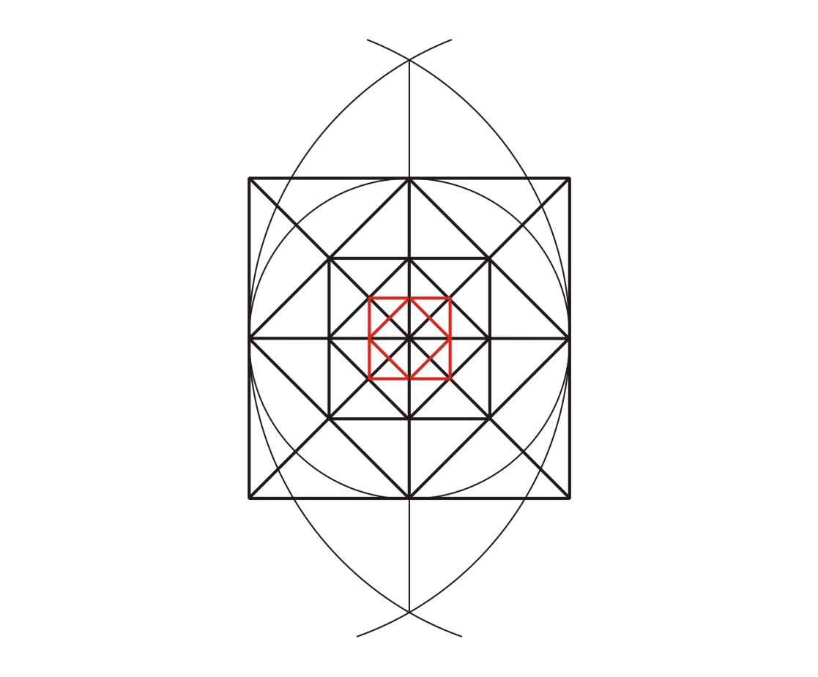

Slide 31
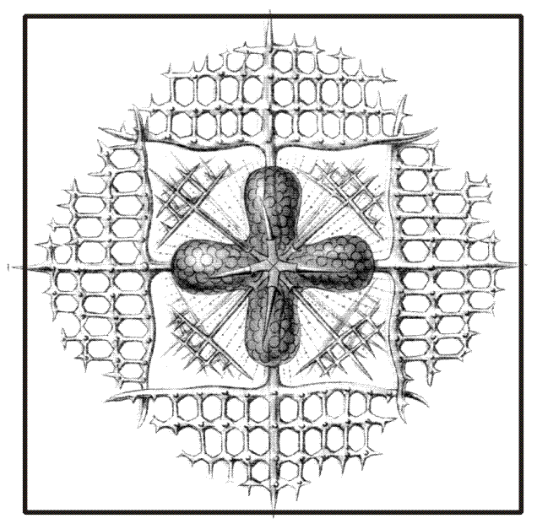
Page 42
Microscopic Radiolarian

Slide 32
Page 42
Nature tries to match the geometric ideal but can never equal it. Instead we get endlessly diverse approximations

Slide 33

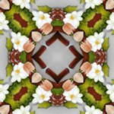
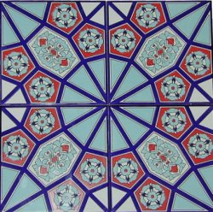
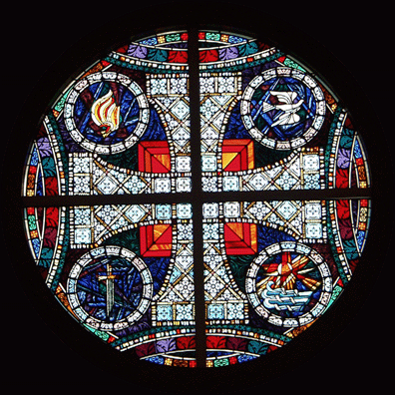
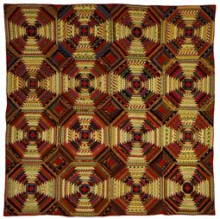
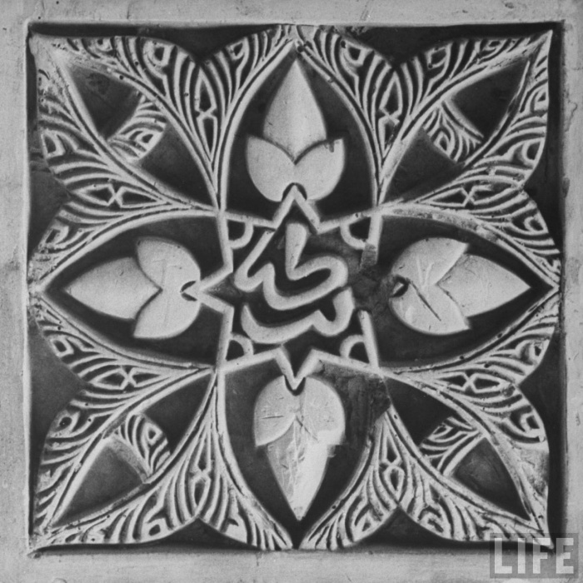

Slide 34
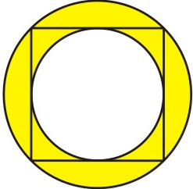
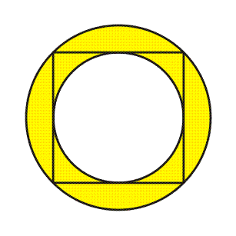
A Square Balances Two Circles:
Area of the Yellow Ring = Area of the White Circle
Greek
Mayan
French
English
This conveys a visual sense of balance to an object
without the viewer consciously realizing it.

Slide 35

Page 43
(For export)

Slide 36

Page 44
“Mandala”
Manda – mind
La - container

Slide 37


Slide 38


Slide 39

What would a personal mandala of your life look like?

Slide 40



Slide 41

www.hoestart.com/

Slide 42


Slide 43


Slide 44

Page 45

Slide 45

Page 46

Slide 46



Page 48

Slide 47






Slide 48



Homework?
Take any idea about 4’s and squares and develop it into something original and wonderful!

Slide 50


Slide 51


Slide 52


Slide 53

Page 47

Slide 54

How many black dots?!

Slide 55


Slide 56







Four Fundamental Forces
or interactions of the Universe:
Gravitation
(between masses)
Electromagnetism
(electric charge/magnetism
electromagnetic spectrum, light)
Strong Nuclear Force
(holds the nucleus of an atom together,
even though the + protons want to repel)
Weak Nuclear Force
(the radioactive decay of atomic nuclei)

